Slide 1
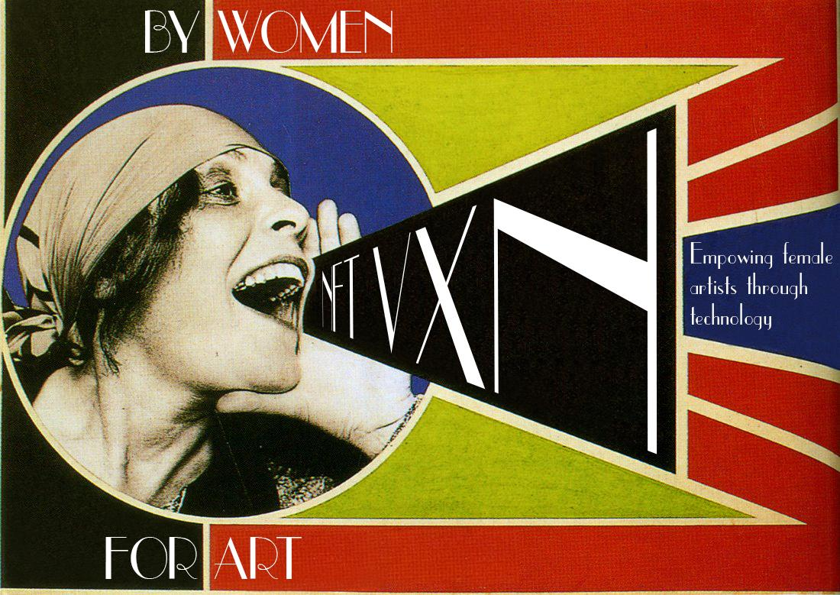

Slide 2

ERC-721 Non-Fungible Tokens
- Smart Contracts that Users Interact With by Calling
Them and Then Receiving Proof of Interaction
- Allow for Tokenization of Unique Art, Collectibles, Real estate, etc
- Represent Sole (indisputable) Ownership
- Secured Immutable Public Record by and on Ethereum Blockchain
- Each Token Minted Has a Unique Identifier
- Compatible with Anything Built Using Ethereum
- Can Be Bought and Sold as Asset Class
on Any Ethereum-Based NFT Market
WHAT ARE NFTs?

Slide 3
NFT Market
- Current Market Cap for Ethereum NFT (ERC- 721) $338 million
- Year 2021 Projected to Quadruple to $1.3 billion
Notable Sales Data
- NBA Top Shot Generated $230 Million of Digital NBA Highlights
- Beeple’s Everydays: The First 5000 Days sold for $69 million
- Crypto Kitties Collectible Cards NFTs Sold at Over $300,000 Each
- Krista Kim’s Mars House Sold for 500 Ethereum
- CryptoPunks Sold for $16.9 Million
- Jack Dorsey First Tweet NTF Sold for $2.9 Million
Beyond Art and Collectibles = ENDLESS POSSIBILITIES
WHY NFTs?
NTFs
- More Visibility and Power to Creatives to Sell
Their Work Accessing Global Market
- Establish Universal Royalties Standard to Artists
(Including Embedded Royalties for Continuous
Payment Upon Resale)
- Owner Verified Through NFT Contract Similar to
Deed or Certificate of Authenticity
- Emphasizing Importance and Value of
DIGITAL CONTENT

Slide 4
WOMEN FOR ART
A CALL TO ACTION
NFTs BY WOMEN

Slide 5
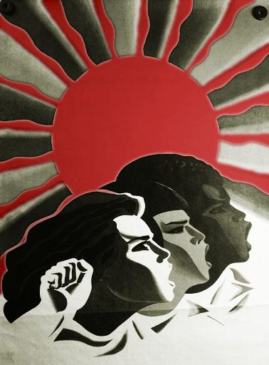
WOMEN IN ART PRESENTLY
- No Women in the Top 0.03% of the Auction Market
Where 41% of the Profit is Concentrated
- 96% of Artworks Sold at Auction are by Male Artists
- Of over 3,000 Galleries in the Artsy Database, 10%
Represent Not a Single Woman Artist, While Only 8%
Represent More Women than Men
- Almost Half Represent 25% or Fewer Women
- Just 11% of All Acquisitions and 14% of Exhibitions at
26 Prominent U.S. Museums Over the Past Decade
Were of Work by Female Artists
- Women Earn 70% of Bachelor of Fine Arts and
65–75% of Master of Fine Arts Degrees in the U.S.,
Though Only 46% of Working Artists (Across All Arts
Disciplines) are Women
- Women Make up Only About 15% of Crypto Users
- While Most NFT Marketplaces Give artists Equal and
Direct Access to Collectors, Most Artists Making the
Biggest Sales are Predominantly Male

Slide 6

NFT VXN
“Promoting Global Female Artistic
Empowerment and Advancement
through Technology!”
- NFTVXN.com (website demo)
- Gallery and Sales Platform
- VXN Lair Foundation
- Single Edition Art and Design works
- Digital and Tangible Artworks
- Auction or Set Price
- Embedded Royalties into NFTs Determined by Artist
- 4% Purchase Fee
- 3% Cover Business Operations
- 1% Converted to VXN (VIXEN) Native Token
for Promotion of VXN Lair Foundation

Slide 7
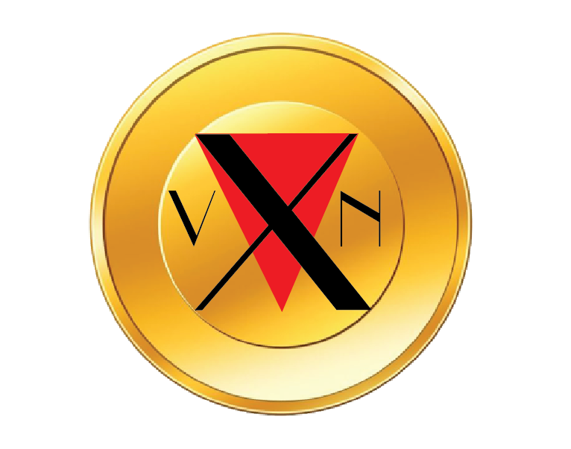
VIXEN TOKEN CROWDSALE
Turning NFT VXN into Reality Through the Issuance of Tokens
- To Occur 1-2 Months Prior NFTVXN.com Launch
- Funding for Software Developers, Marketing Budgets,
Operations Costs, etc
- Post Crowd Sale VXNs Will Be Bought and Sold on the Open Market
- Indicative of Interest in NFT VXN Project and
Adjustment of Business Model Accordingly
- Ether as form of payment
- $0.20 Crowdsale Price
- Timed 4 weeks
Implementation of VXN Token
- 1% of Total Purchase Fee will be Converted from Ether
to VXN to fund VXN Lair Foundation
- 1000 VXN Give Away Per 1 Eth Purchase (50/50)
artist/buyer split) for the first 1-2 months
Goal: All Transactions Executed in VXN

Slide 8

VXN Native ERC-20 Token

Slide 9
NFTVXN.com FLOW
- Artist sets up her Metamask (Google Chrome extension) wallet
- Purchases Eth to Cover the Gas Fees
- Connects her Metamask to NFTVXN.com
- Uploads the Image, Video File, or Gif of Artwork Along with Relevant Info
- Chooses “create” Option to Initializes the Wallet
- Uploads the Files and Mints her NFT Token
- She Signs the Sell Order Upon Which NFT is Minted
- She then Proceeds to Put it for Sale (or auction) by Assigning Her Price and Confirming its for Sale Status
- Buyer Sets Up Their Metamask Wallet
- Connects it to NFTVXN.com
- Confirms or Transfers Sufficient Funds
- Selects Artwork and Proceed to Checkout
- Upon Successful Transaction They Will be Proud Owner of Unique NFT
(Which Will Serves as Their Certificate of Authenticity with Undisputed Ownership)
*For the first few months NFT VXN will offer bonus of 500 VXN tokens each to both artist and buyer for every 1 Eth + purchase

Slide 10
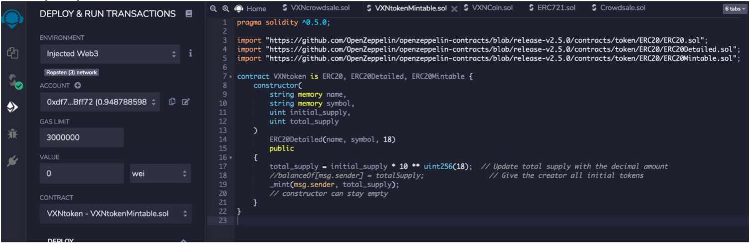
BackEnd 1
VXNtokenMintable.sol Contract, which Allows Us Create Our VXN Token and Prepare It for Crowdsale:

Slide 11
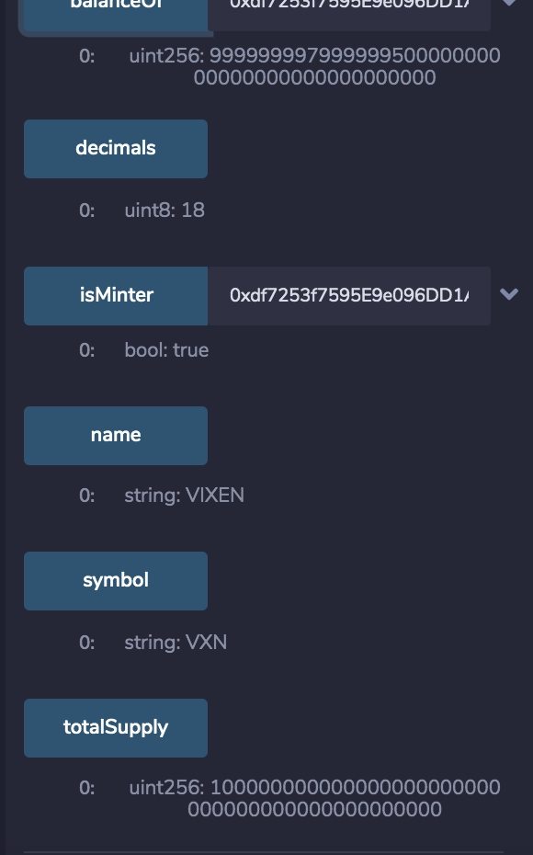
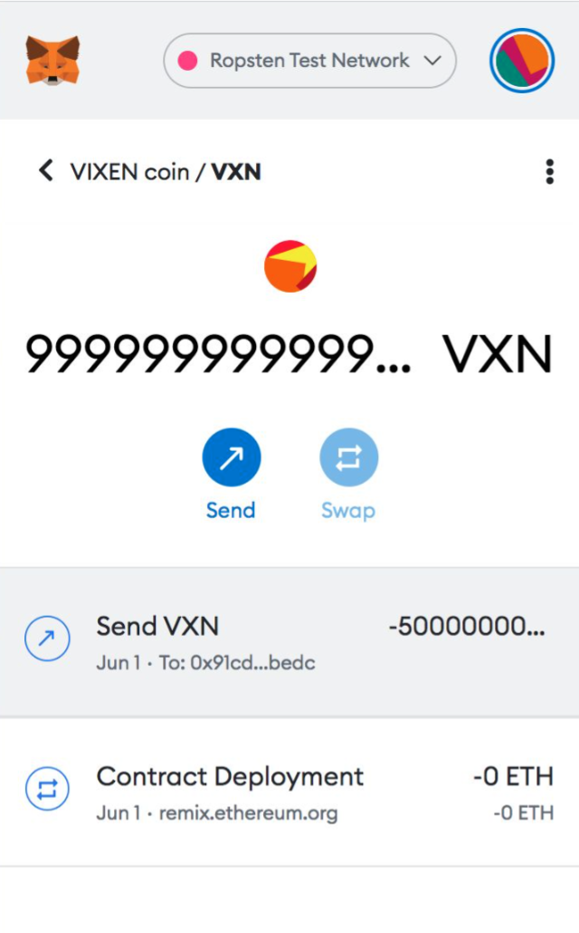
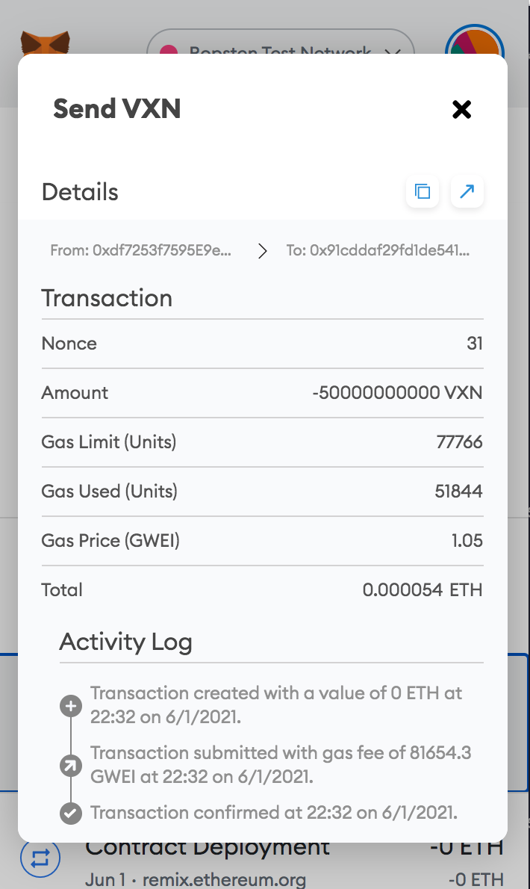
BackEnd 2
ERC20 token VIXEN, with a symbol of VXN and a total supply of 100 billion with the total supply assigned to the creator of the contract.
Our VXN token in MetaMask account:
Confirmation of test VXN token transaction:

Slide 12
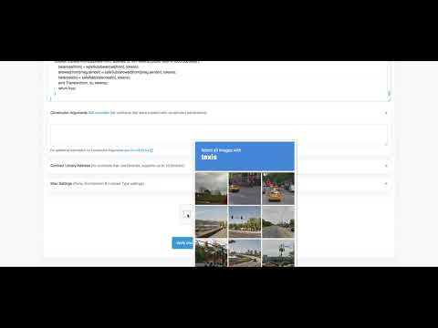
Verifying and publishing our contract on Ethereum blockchain:

Slide 13
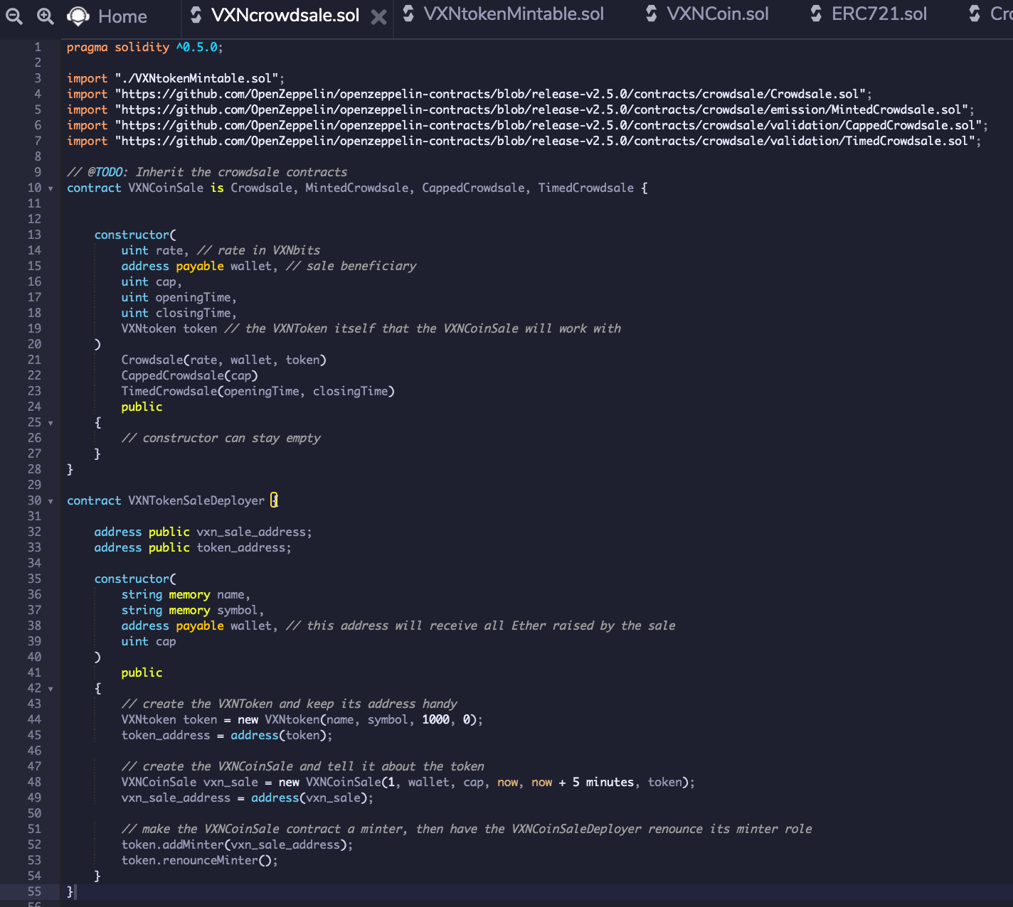
BackEnd 3
VXNcrowdsale.sol Contract, Which will Help Fund the Project Development.

Slide 14
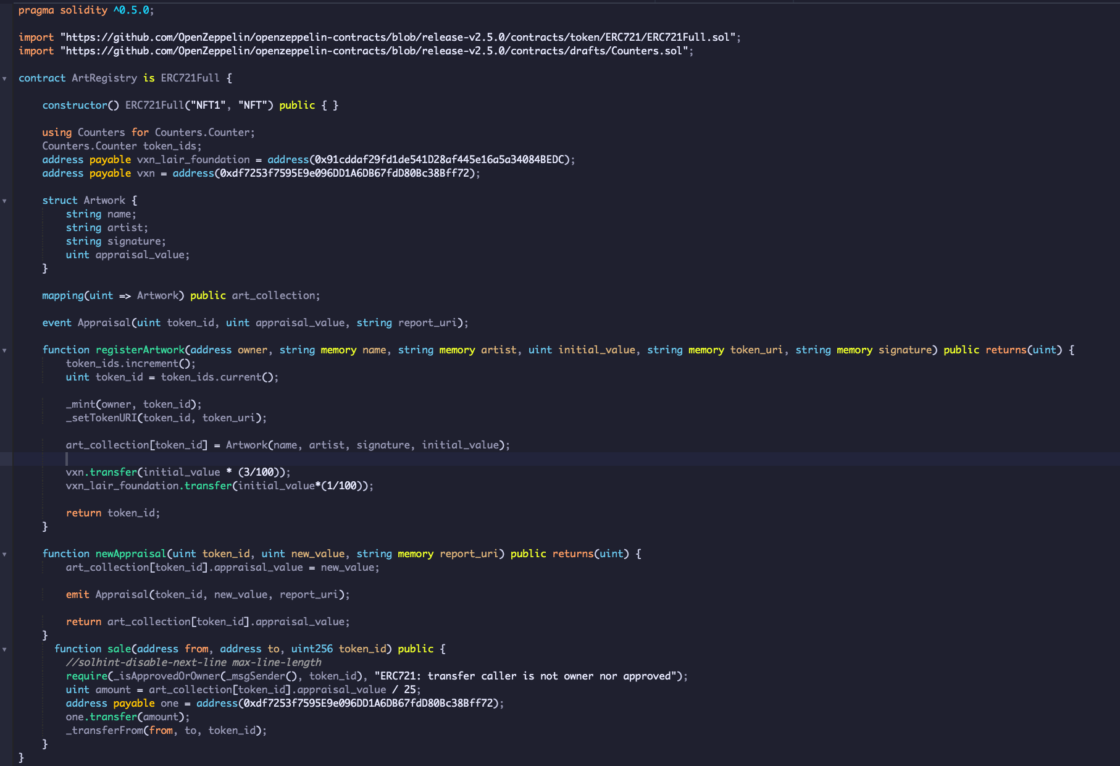
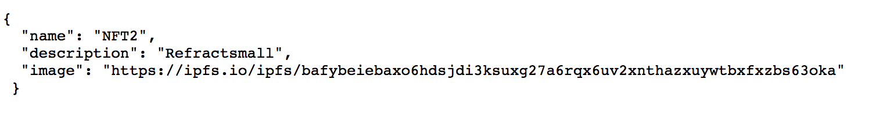
BackEnd 4
Creation of NFTs Using ERC-721 OpenZeppelin Contract.
In This Contract 3% of ETH from the Sale Goes to NFT VXN Operations, 1% Gets Converted to VXN Token and Goes to Fund VXN Lair Foundation.
A URI is a Uniform Resource Identifier for NFT:

Slide 15
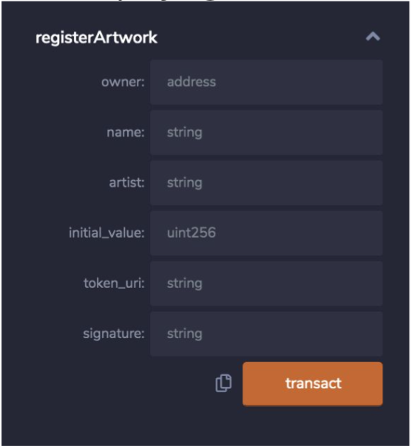
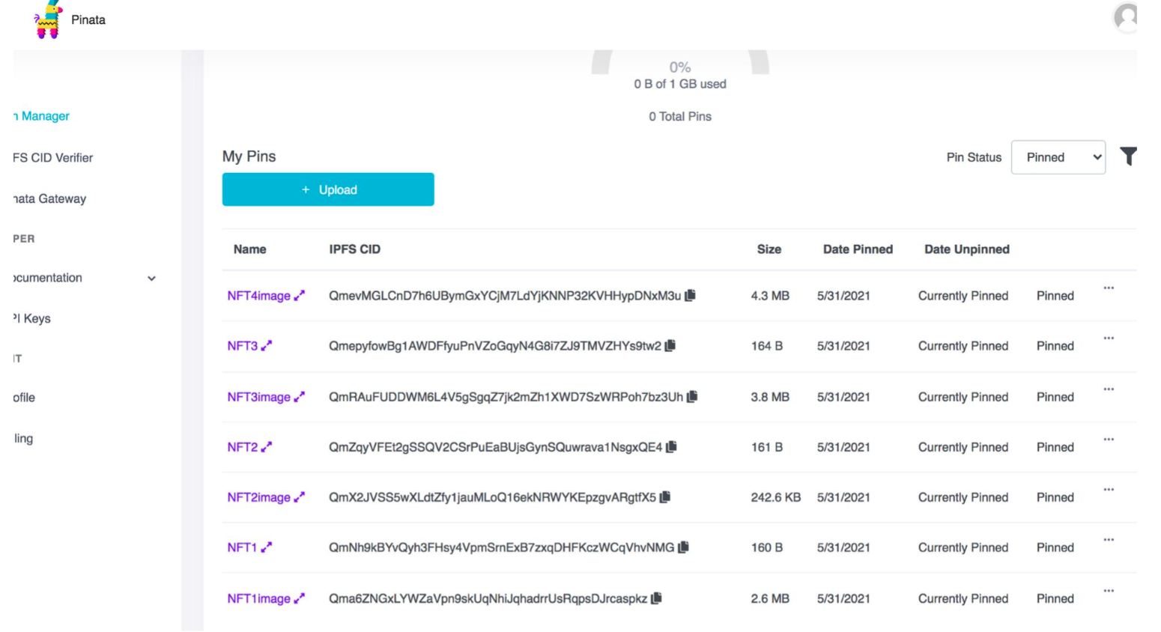
BackEnd 5
Registering NFTs:
All of Our NFTs Stored in IPFS Pinning Service – Pinata:

Slide 16
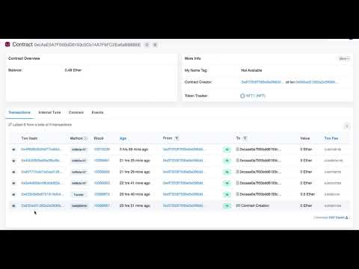
Transactions of Registering NFTs on Eatherscan:

Slide 18
ERC-721 Non-Fungible Tokens
- Smart Contracts that Users Interact With by Calling
Them and Then Receiving Proof of Interaction
- Allow for Tokenization of Unique Art, Collectibles, Real estate, etc
- Represent Sole (indisputable) Ownership
- Secured Immutable Public Record by and on Ethereum Blockchain
- Each Token Minted Has a Unique Identifier
- Compatible with Anything Built Using Ethereum
- Can Be Bought and Sold as Asset Class
on Any Ethereum-Based NFT Market
WHAT ARE NFTs?

Slide 19
NFT Market
- Current Market Cap for Ethereum NFT (ERC- 721) $338 million
- Year 2021 Projected to Quadruple to $1.3 billion
Notable Sales Data
- NBA Top Shot Generated $230 Million of Digital NBA Highlights
- Beeple’s Everydays: The First 5000 Days sold for $69 million
- Crypto Kitties Collectible Cards NFTs Sold at Over $300,000 Each
- Krista Kim’s Mars House Sold for 500 Ethereum
- CryptoPunks Sold for $16.9 Million
- Jack Dorsey First Tweet NTF Sold for $2.9 Million
Beyond Art and Collectibles = ENDLESS POSSIBILITIES
WHY NFTs?
NTFs
- More Visibility and Power to Creatives to Sell
Their Work Accessing Global Market
- Establish Universal Royalties Standard to Artists
(Including Embedded Royalties for Continuous
Payment Upon Resale)
- Owner Verified Through NFT Contract Similar to
Deed or Certificate of Authenticity
- Emphasizing Importance and Value of
DIGITAL CONTENT

Slide 20
WOMEN FOR ART
A CALL TO ACTION
NFTs BY WOMEN

Slide 21
WOMEN IN ART PRESENTLY
- No Women in the Top 0.03% of the Auction Market
Where 41% of the Profit is Concentrated
- 96% of Artworks Sold at Auction are by Male Artists
- Of over 3,000 Galleries in the Artsy Database, 10%
Represent Not a Single Woman Artist, While Only 8%
Represent More Women than Men
- Almost Half Represent 25% or Fewer Women
- Just 11% of All Acquisitions and 14% of Exhibitions at
26 Prominent U.S. Museums Over the Past Decade
Were of Work by Female Artists
- Women Earn 70% of Bachelor of Fine Arts and
65–75% of Master of Fine Arts Degrees in the U.S.,
Though Only 46% of Working Artists (Across All Arts
Disciplines) are Women
- Women Make up Only About 15% of Crypto Users
- While Most NFT Marketplaces Give artists Equal and
Direct Access to Collectors, Most Artists Making the
Biggest Sales are Predominantly Male

Slide 22
NFT VXN
“Promoting Global Female Artistic
Empowerment and Advancement
through Technology!”
- NFTVXN.com (website demo)
- Gallery and Sales Platform
- VXN Lair Foundation
- Single Edition Art and Design works
- Digital and Tangible Artworks
- Auction or Set Price
- Embedded Royalties into NFTs Determined by Artist
- 4% Purchase Fee
- 3% Cover Business Operations
- 1% Converted to VXN (VIXEN) Native Token
for Promotion of VXN Lair Foundation

Slide 23
VIXEN TOKEN CROWDSALE
Turning NFT VXN into Reality Through the Issuance of Tokens
- To Occur 1-2 Months Prior NFTVXN.com Launch
- Funding for Software Developers, Marketing Budgets,
Operations Costs, etc
- Post Crowd Sale VXNs Will Be Bought and Sold on the Open Market
- Indicative of Interest in NFT VXN Project and
Adjustment of Business Model Accordingly
- Ether as form of payment
- $0.20 Crowdsale Price
- Timed 4 weeks
Implementation of VXN Token
- 1% of Total Purchase Fee will be Converted from Ether
to VXN to fund VXN Lair Foundation
- 1000 VXN Give Away Per 1 Eth Purchase (50/50)
artist/buyer split) for the first 1-2 months
Goal: All Transactions Executed in VXN

Slide 24
VXN Native ERC-20 Token

Slide 25
NFTVXN.com FLOW
- Artist sets up her Metamask (Google Chrome extension) wallet
- Purchases Eth to Cover the Gas Fees
- Connects her Metamask to NFTVXN.com
- Uploads the Image, Video File, or Gif of Artwork Along with Relevant Info
- Chooses “create” Option to Initializes the Wallet
- Uploads the Files and Mints her NFT Token
- She Signs the Sell Order Upon Which NFT is Minted
- She then Proceeds to Put it for Sale (or auction) by Assigning Her Price and Confirming its for Sale Status
- Buyer Sets Up Their Metamask Wallet
- Connects it to NFTVXN.com
- Confirms or Transfers Sufficient Funds
- Selects Artwork and Proceed to Checkout
- Upon Successful Transaction They Will be Proud Owner of Unique NFT
(Which Will Serves as Their Certificate of Authenticity with Undisputed Ownership)
*For the first few months NFT VXN will offer bonus of 500 VXN tokens each to both artist and buyer for every 1 Eth + purchase

Slide 26
BackEnd 1
VXNtokenMintable.sol Contract, which Allows Us Create Our VXN Token and Prepare It for Crowdsale:

Slide 27
BackEnd 2
ERC20 token VIXEN, with a symbol of VXN and a total supply of 100 billion with the total supply assigned to the creator of the contract.
Our VXN token in MetaMask account:
Confirmation of test VXN token transaction:

Slide 28
Verifying and publishing our contract on Ethereum blockchain:

Slide 29
BackEnd 3
VXNcrowdsale.sol Contract, Which will Help Fund the Project Development.

Slide 30
BackEnd 4
Creation of NFTs Using ERC-721 OpenZeppelin Contract.
In This Contract 3% of ETH from the Sale Goes to NFT VXN Operations, 1% Gets Converted to VXN Token and Goes to Fund VXN Lair Foundation.
A URI is a Uniform Resource Identifier for NFT:

Slide 31
BackEnd 5
Registering NFTs:
All of Our NFTs Stored in IPFS Pinning Service – Pinata:

Slide 32
Transactions of Registering NFTs on Eatherscan:

Slide 33
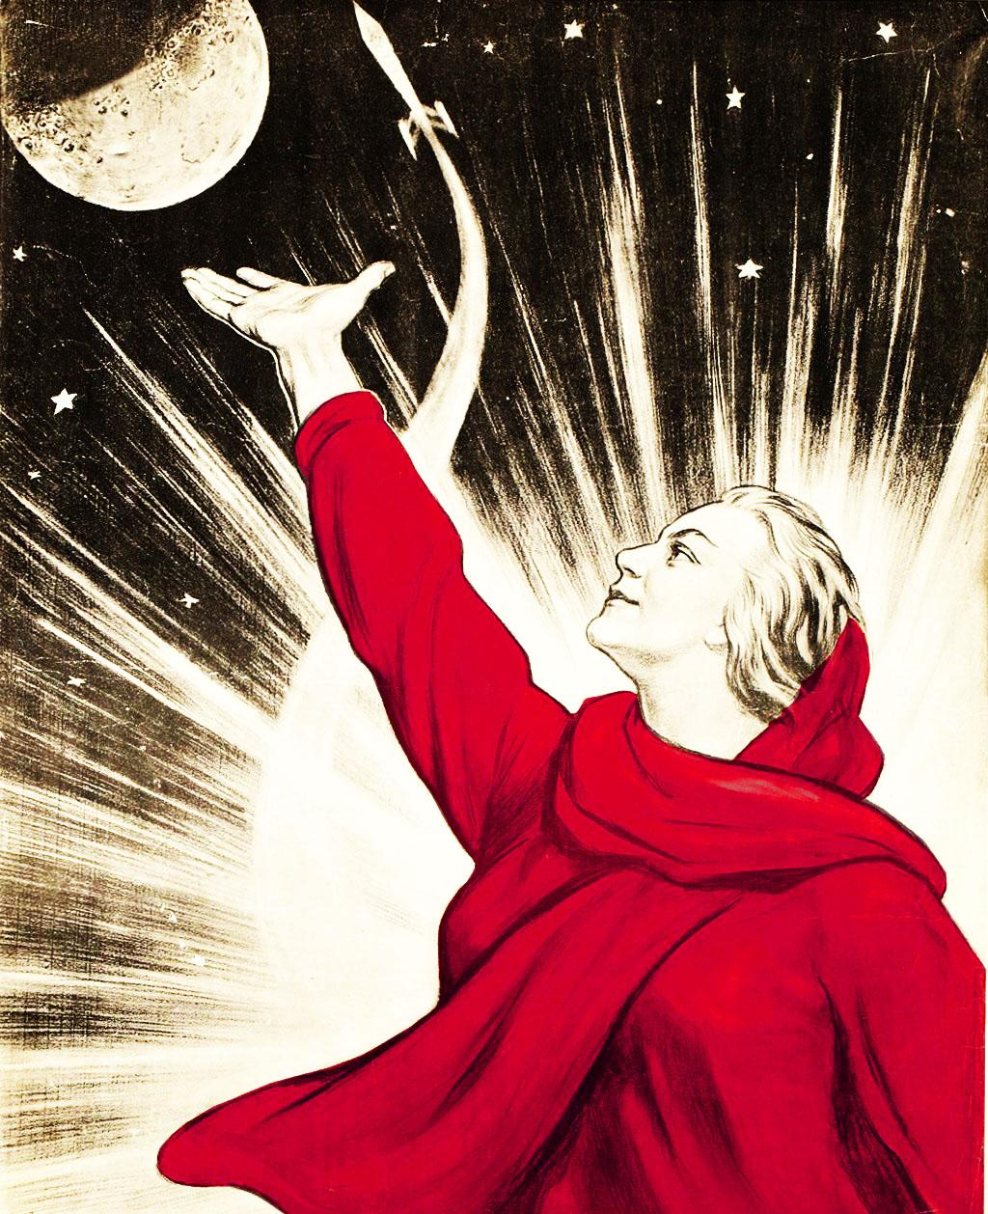
Future NFT VXN
- Wider Audiences- Expand NFT VXN to include MP4s, ALS, MOV, MLB formats
- Shift to more exclusive curated platform
- Grow VXN Lair Foundation with
- Educational Focus
- Curatorial Programming
- Support Collaborative Residences
- Grow VXN Token as Asset Class
- Help Fund Female Creative StartUps
Facilitate First Female Digital Artist Art Fair

Slide 34
,
Thank you!

Slide 35
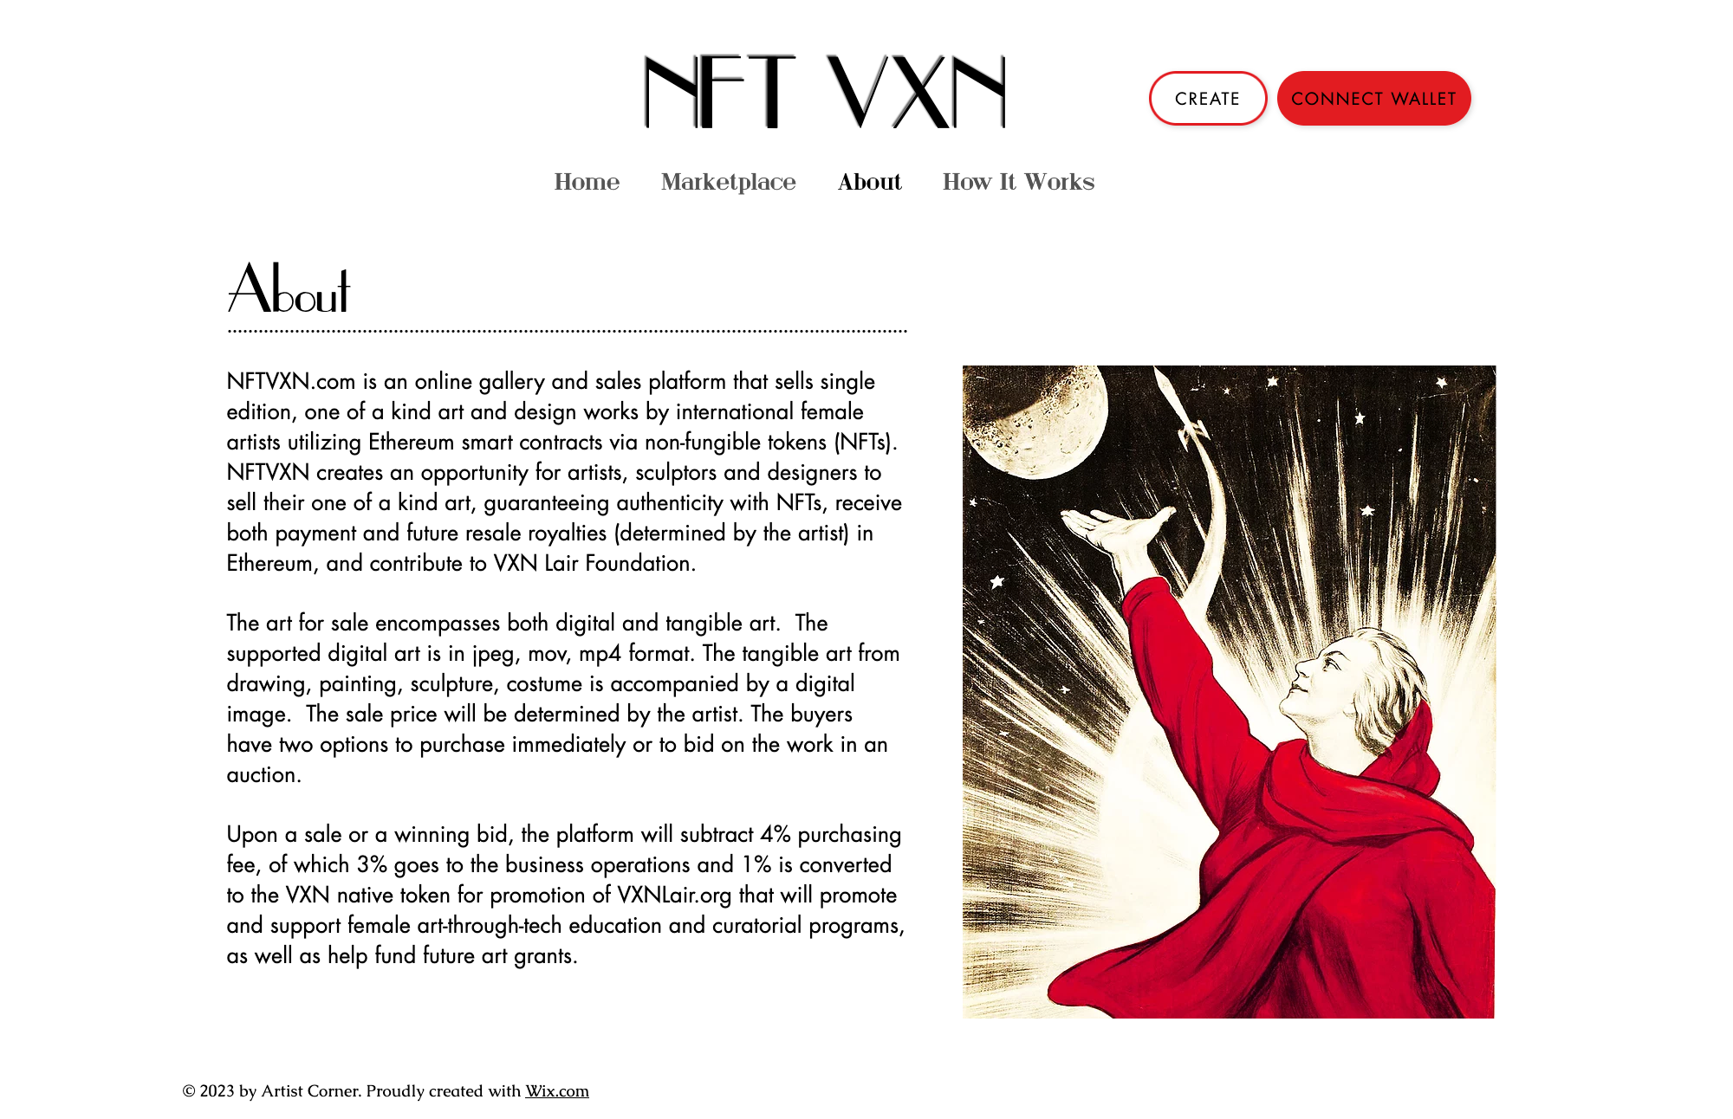

Slide 36
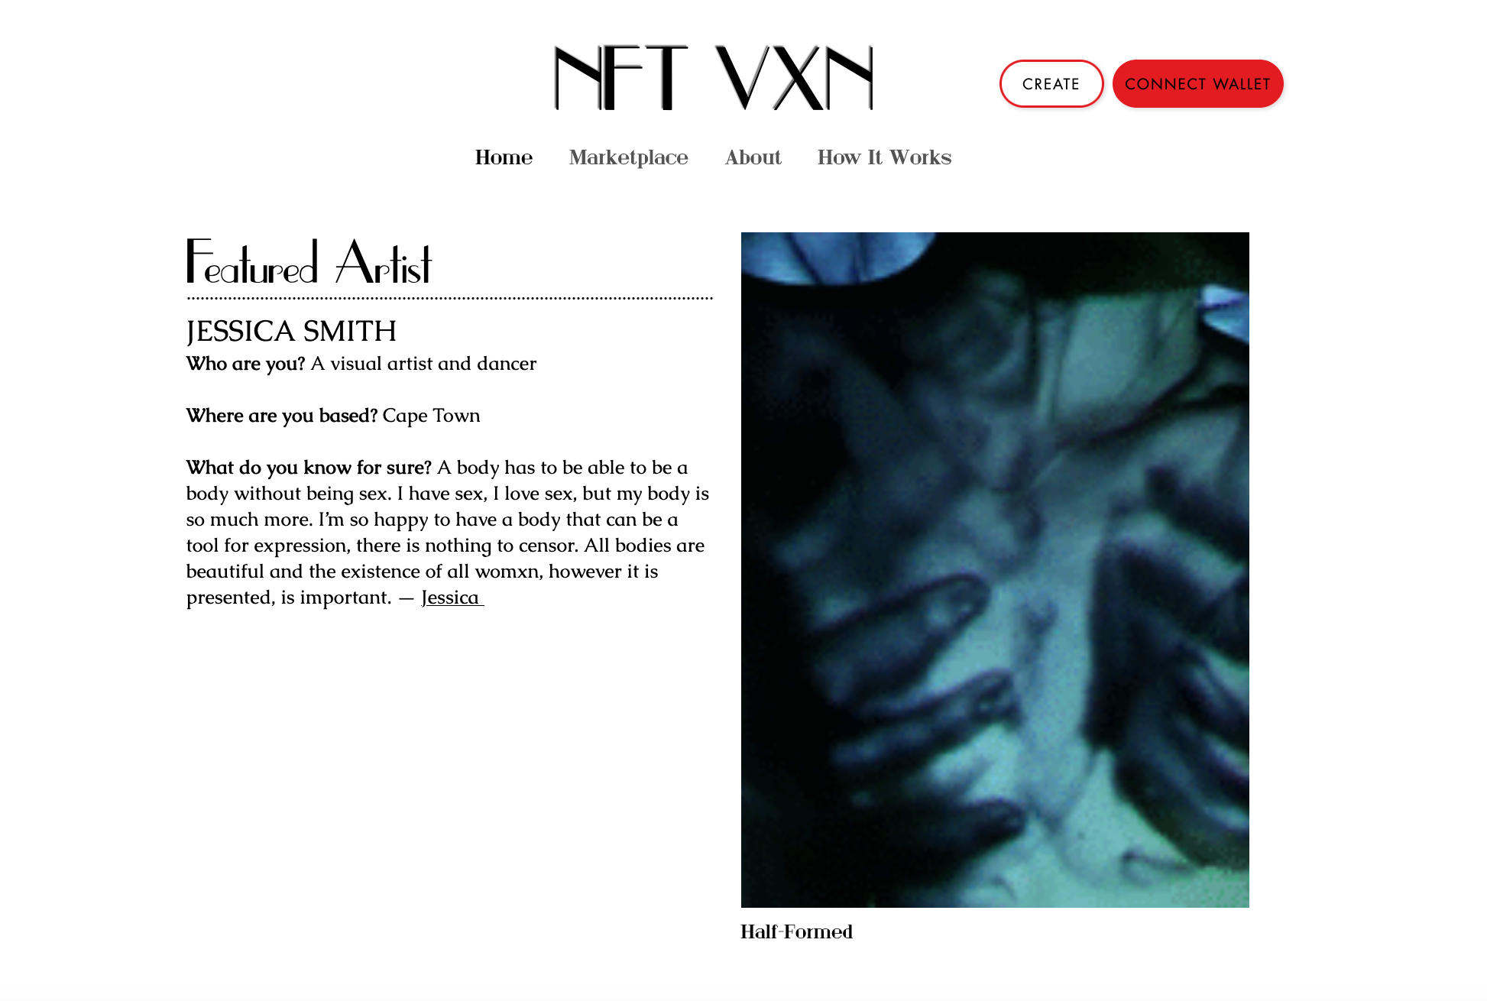

Slide 37
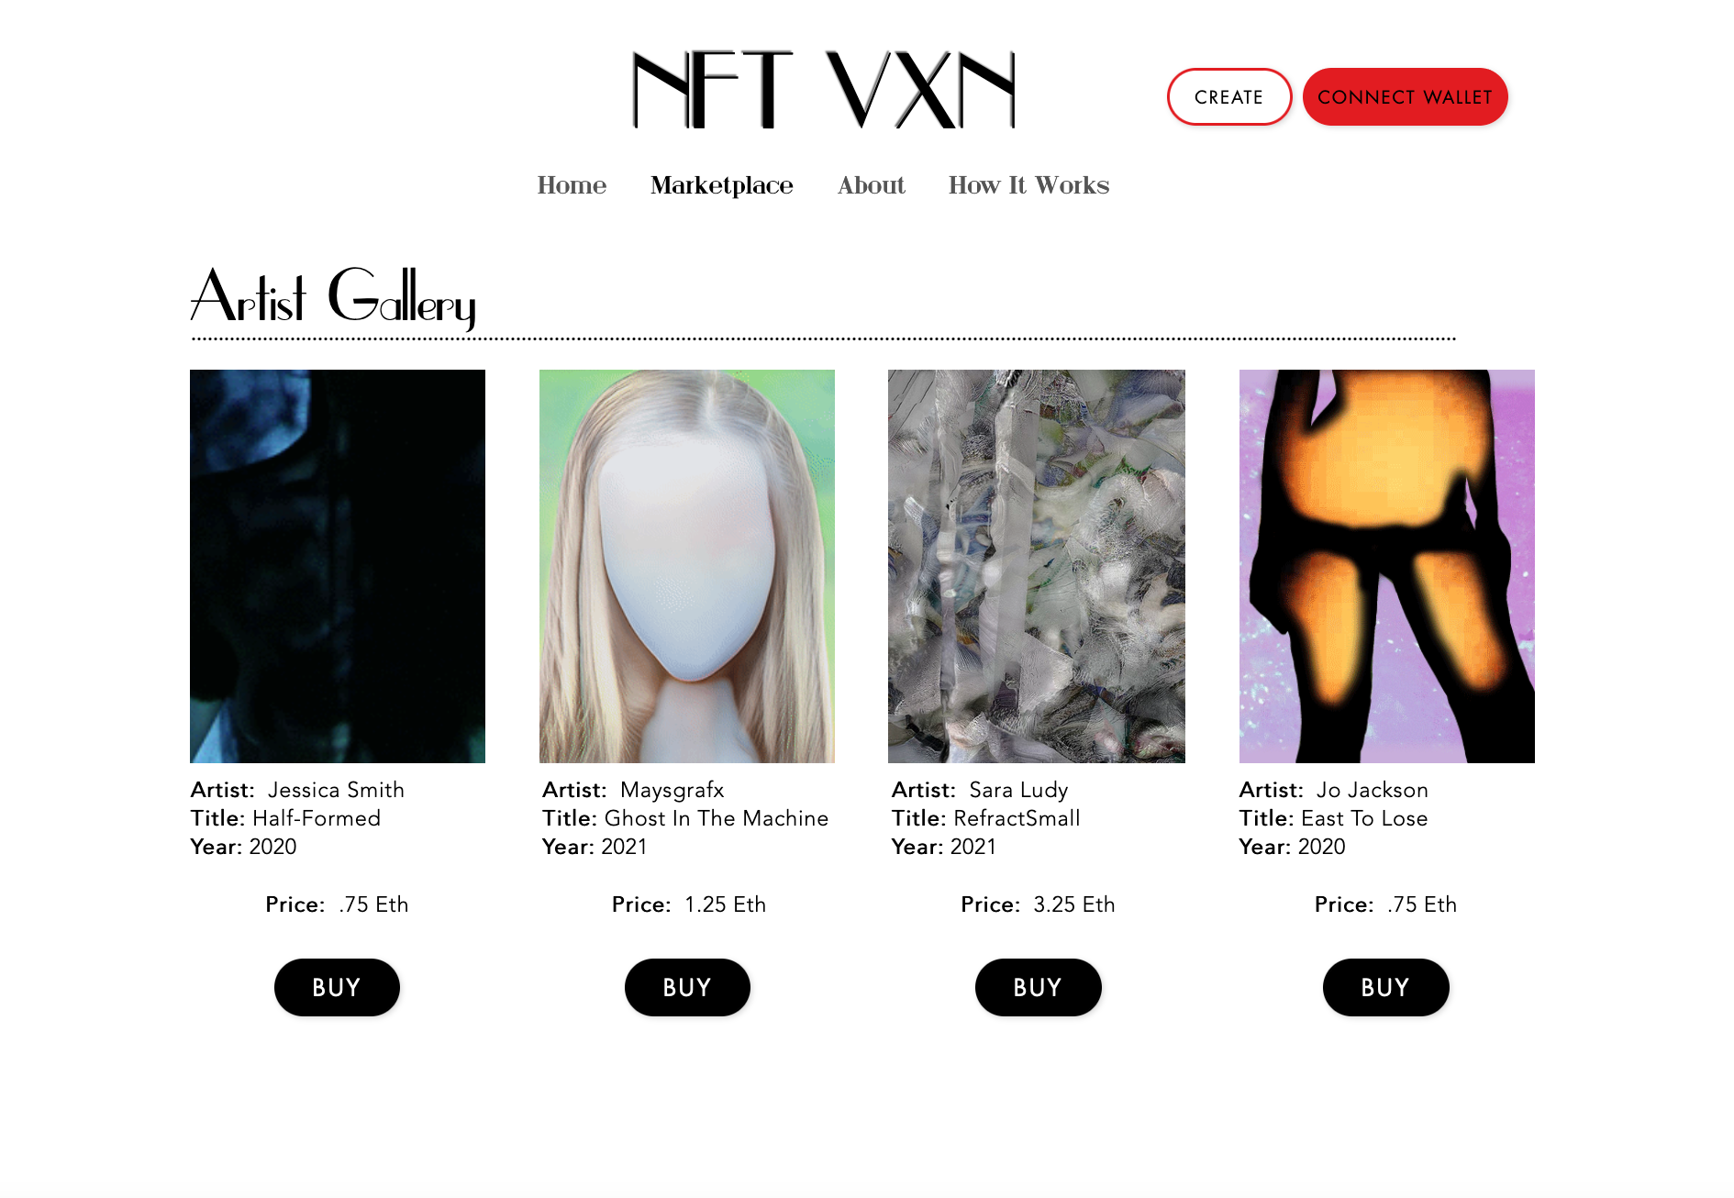

Slide 38
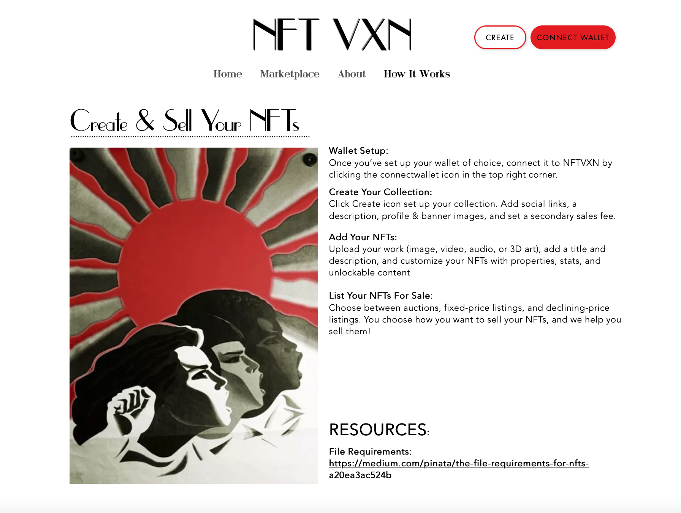

Slide 40
Future NFT VXN
- Wider Audiences- Expand NFT VXN to include MP4s, ALS, MOV, MLB formats
- Shift to more exclusive curated platform
- Grow VXN Lair Foundation with
- Educational Focus
- Curatorial Programming
- Support Collaborative Residences
- Grow VXN Token as Asset Class
- Help Fund Female Creative StartUps
Facilitate First Female Digital Artist Art Fair

Slide 41
,
Thank you!

